Slide 1

Quantum Algorithm Grand Challenge 2024: A Special Ansatz Approach
QAGC 2024
Date: 30th June 2024
SU(N) Solver for Fermi-Hubbard Models
Team Name: SU(N)-QSim
Team Members:
Tina Oberoi (U. Chicago),
Xiaoren Li (U. Waterloo)
and Kuan-Cheng Chen (Imperial College London)

Slide 2
Introduction to Quantum Algorithm Grand Challenge
Quantum chemistry one of the most promising candidate for NISQ applications.
But still far from achieving the quantum advantage.
Besides high fidelity we need useful NISQ algorithms, defined evaluation criteria for performance comparisons.
QAGC Focus:
。 Practical Applications based NISQ algorithm
。Evaluation criteria for performance benchmarking
Introduction
Notes:
The principle of TR-EPR is to detect the transitions of electrons between each non-degenerate vibrational energy
levels. For monitoring these transitions the EPR sample needs to be placed in a microwave cavity which
is exposed to a variable applied magnetic field and continuous microwave irradiation that has a wavelength
that resonant with EPR transitions at particular field strengths. Depending on the population distribution,
the transitions of the sample’s EPR are induced by the emission or absorption of the microwave
irradiation in the cavity. For inducing the Zeeman split, an external magnetic field is generated by a magnet
surrounding the microwave cavity, and the transition frequency between this split energy level
which means the cavity is on resonance

Slide 3
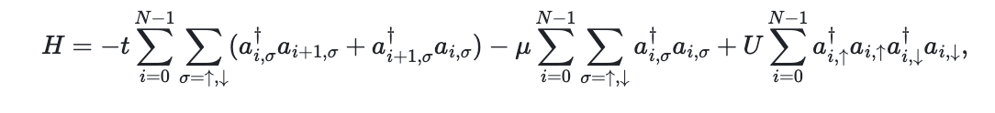
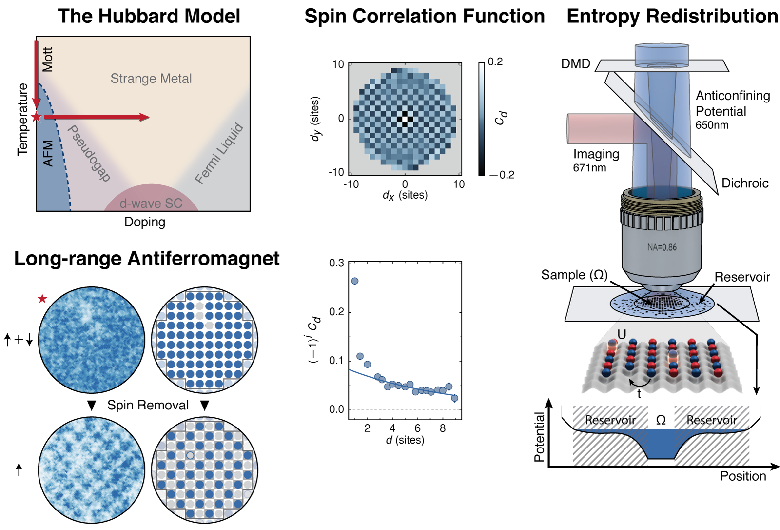
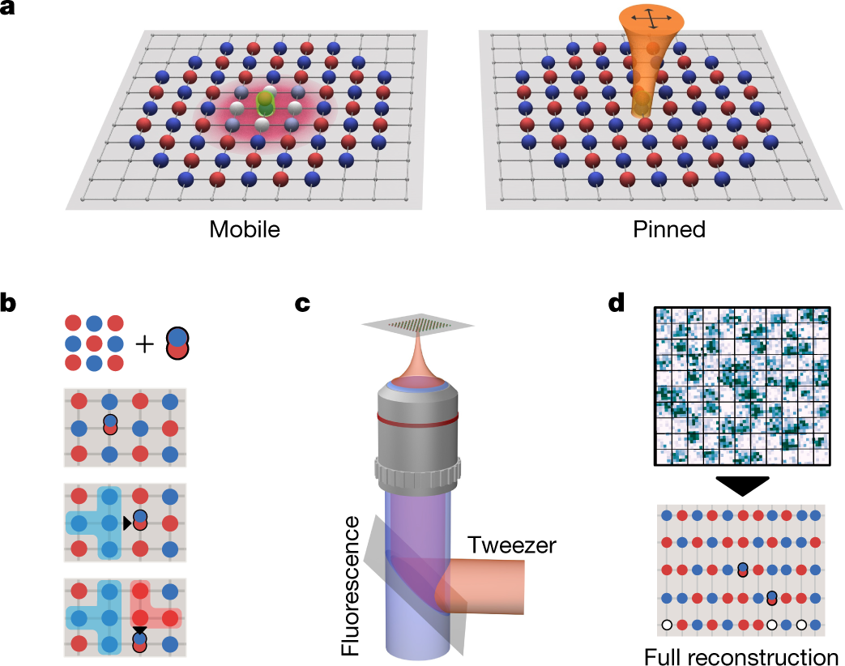
Problem Description
In quantum chemistry ground state an important quantity for understanding a system.
Goal of QAGC 2024: Find ground state energy of the Fermi Hubbard Model
Fermi Hubbard Model describes properties of strongly correlated electron systems.
Used to explain phenomena such as magnetism, Mott insulators, and high-temperature superconductors.
Nature 545, 462-466 (2017)
Nature 572, 358–362 (2019)
Introduction
Notes:
The principle of TR-EPR is to detect the transitions of electrons between each non-degenerate vibrational energy
levels. For monitoring these transitions the EPR sample needs to be placed in a microwave cavity which
is exposed to a variable applied magnetic field and continuous microwave irradiation that has a wavelength
that resonant with EPR transitions at particular field strengths. Depending on the population distribution,
the transitions of the sample’s EPR are induced by the emission or absorption of the microwave
irradiation in the cavity. For inducing the Zeeman split, an external magnetic field is generated by a magnet
surrounding the microwave cavity, and the transition frequency between this split energy level
which means the cavity is on resonance

Slide 4
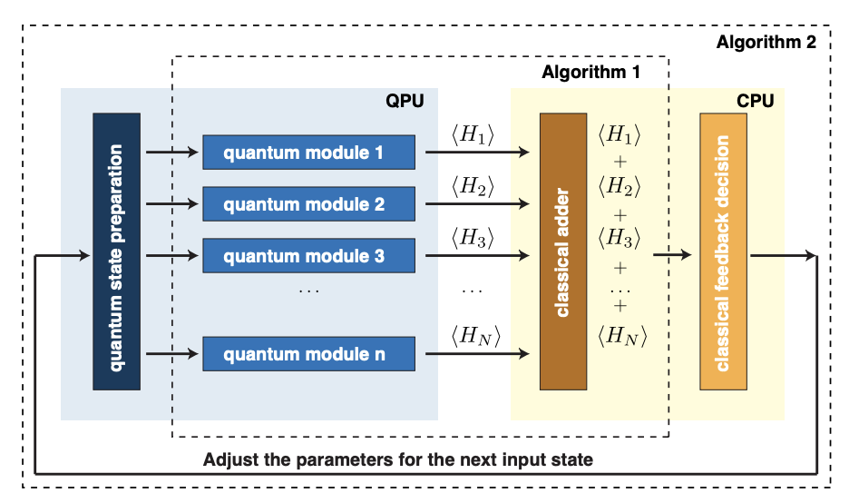
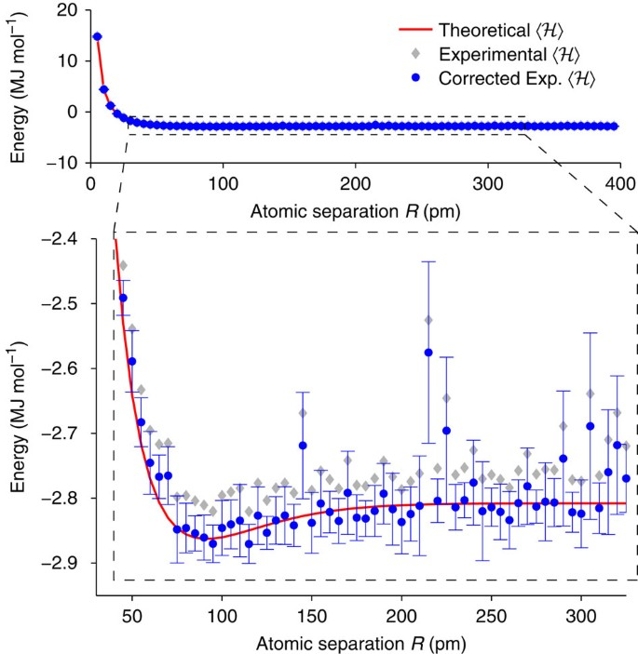
Variational Quantum Eigensolver (VQE)
Hybrid Classical Algorithm based on variational principle.
Provides a way for approximating ground state energy.
VQE uses optimization algorithms to find optimal parameters.
Nature Comm. 5, 4213 (2014)
Introduction
Notes:
The principle of TR-EPR is to detect the transitions of electrons between each non-degenerate vibrational energy
levels. For monitoring these transitions the EPR sample needs to be placed in a microwave cavity which
is exposed to a variable applied magnetic field and continuous microwave irradiation that has a wavelength
that resonant with EPR transitions at particular field strengths. Depending on the population distribution,
the transitions of the sample’s EPR are induced by the emission or absorption of the microwave
irradiation in the cavity. For inducing the Zeeman split, an external magnetic field is generated by a magnet
surrounding the microwave cavity, and the transition frequency between this split energy level
which means the cavity is on resonance

Slide 5
Setup in VQE algorithm
Encode qubit Hamiltonian
Choose parameterized ansatz for state preparation
Measure in the basis of qubit Hamiltonian to get expectation values
Send result to classical optimizer for updated parameters.
Idea
Notes:
The principle of TR-EPR is to detect the transitions of electrons between each non-degenerate vibrational energy
levels. For monitoring these transitions the EPR sample needs to be placed in a microwave cavity which
is exposed to a variable applied magnetic field and continuous microwave irradiation that has a wavelength
that resonant with EPR transitions at particular field strengths. Depending on the population distribution,
the transitions of the sample’s EPR are induced by the emission or absorption of the microwave
irradiation in the cavity. For inducing the Zeeman split, an external magnetic field is generated by a magnet
surrounding the microwave cavity, and the transition frequency between this split energy level
which means the cavity is on resonance

Slide 6
2. Choosing ansatz
3. Optimizers
1. Initialization of state
Crucial for success of VQE algorithm
Proper initialization of the quantum state is essential, as it sets the foundational conditions from which the VQE algorithm begins to explore the solution space, influencing both convergence rate and the likelihood of finding the global minimum.
Selecting an appropriate ansatz is critical for the VQE algorithm because it defines the form and complexity of the quantum circuit, balancing between expressive power to capture the problem's physics and the practicality of implementation on near-term quantum devices.
The choice of optimizers is pivotal in efficiently guiding the algorithm towards the optimal parameters that minimize the energy function, impacting the speed and accuracy of convergence in the VQE process.
Idea
Notes:
The principle of TR-EPR is to detect the transitions of electrons between each non-degenerate vibrational energy
levels. For monitoring these transitions the EPR sample needs to be placed in a microwave cavity which
is exposed to a variable applied magnetic field and continuous microwave irradiation that has a wavelength
that resonant with EPR transitions at particular field strengths. Depending on the population distribution,
the transitions of the sample’s EPR are induced by the emission or absorption of the microwave
irradiation in the cavity. For inducing the Zeeman split, an external magnetic field is generated by a magnet
surrounding the microwave cavity, and the transition frequency between this split energy level
which means the cavity is on resonance

Slide 7



State Initialization: Hartree-Fock (HF)
HF Method: Provides a mean-field approximation of the electronic wavefunction, serving as a foundational step in computational chemistry.
Initial Guess for VQE: The HF wavefunction, typically close to the true ground state wavefunction for many systems, serves as a reliable initial guess for the more accurate but computationally expensive VQE.
Parameterization in VQE involves VQE parameters (θ) to optimize the variational quantum circuit for energy minimization, basis expansion coefficients (c) to adjust the contribution of each basis function, and basis function parameters (β) to define the characteristics of the basis functions used in the Hartree-Fock wavefunction.
Basis expansion coefficient
VQE parameters
Basis function parameters
Experiment
Notes:
The principle of TR-EPR is to detect the transitions of electrons between each non-degenerate vibrational energy
levels. For monitoring these transitions the EPR sample needs to be placed in a microwave cavity which
is exposed to a variable applied magnetic field and continuous microwave irradiation that has a wavelength
that resonant with EPR transitions at particular field strengths. Depending on the population distribution,
the transitions of the sample’s EPR are induced by the emission or absorption of the microwave
irradiation in the cavity. For inducing the Zeeman split, an external magnetic field is generated by a magnet
surrounding the microwave cavity, and the transition frequency between this split energy level
which means the cavity is on resonance

Slide 8


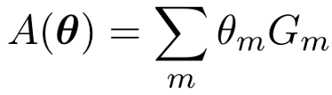
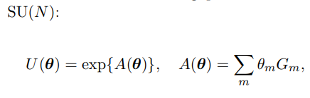
Choosing an ansatz
General Ansatz : Parameterized circuits made of one/two qubit gates. Usually of the form
Need for Ansatz: An ansatz that could optimize with fewer iterations.
Idea: FAMILY of PARAMETERISED UNITARIES
Experiment
Notes:
The principle of TR-EPR is to detect the transitions of electrons between each non-degenerate vibrational energy
levels. For monitoring these transitions the EPR sample needs to be placed in a microwave cavity which
is exposed to a variable applied magnetic field and continuous microwave irradiation that has a wavelength
that resonant with EPR transitions at particular field strengths. Depending on the population distribution,
the transitions of the sample’s EPR are induced by the emission or absorption of the microwave
irradiation in the cavity. For inducing the Zeeman split, an external magnetic field is generated by a magnet
surrounding the microwave cavity, and the transition frequency between this split energy level
which means the cavity is on resonance

Slide 9
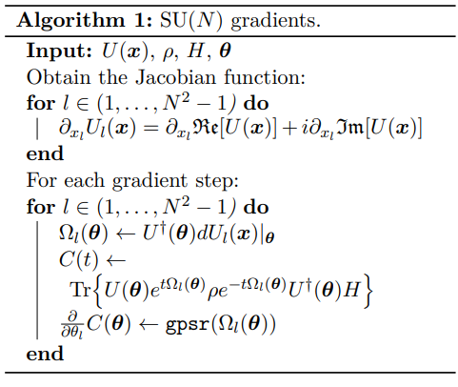
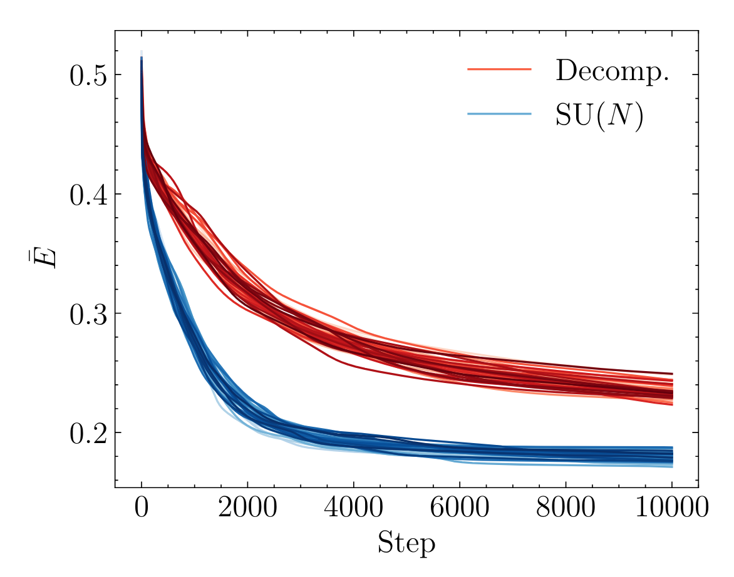
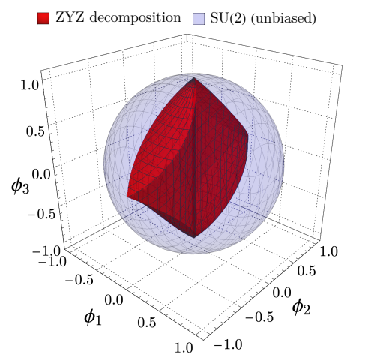
Formulating Ansatz with Special Unitary Gate SU(N)
Gate Speed Limit: The adoption of SU(N) allows us to investigate the speed limit in terms of gate time. The normalized Hamiltonian ensures that the total path length covered by the evolution is directly proportional to the evolution time, effectively setting the speed of the evolution to 1.
Geodesic Path: SU(N) can be transformed into a Riemannian manifold, where the unitary evolution U(θ,t) follows a geodesic path from the identity element, ensuring minimal path length and, consequently, minimum evolution time for generating the desired unitary transformation.
Efficient Gate Decomposition: As expected, decomposing a gate into two gates results in a longer total evolution time than using a single SU(N) gate due to the normalizations of φ¹, φ² and θ. A decomposition into more gates would generally lead to an even greater evolution time
Better Performance
Quantum 8, 1275 (2024).
Experiment
Notes:
The principle of TR-EPR is to detect the transitions of electrons between each non-degenerate vibrational energy
levels. For monitoring these transitions the EPR sample needs to be placed in a microwave cavity which
is exposed to a variable applied magnetic field and continuous microwave irradiation that has a wavelength
that resonant with EPR transitions at particular field strengths. Depending on the population distribution,
the transitions of the sample’s EPR are induced by the emission or absorption of the microwave
irradiation in the cavity. For inducing the Zeeman split, an external magnetic field is generated by a magnet
surrounding the microwave cavity, and the transition frequency between this split energy level
which means the cavity is on resonance

Slide 10
Results for QAGC 2024
Qubits | Value | Error (%) | Time Taken | Task Score
4 | -3.99 | 0.25 | 21 sec | 0.01
12 | -12.69 | 5.5 | 7 hrs | 0.78
20 | -20.50 | 6.8 | 25 hrs | 1.54
28 | -28.69 | 6.6 | 118 hrs | 2.05
The setup of our SU(N) algorithm:
*Depth 2 steps 200* *SLSQP Optimizer*
Note: The error can be reduced by executing more steps (says 2000), but it will definely take longer.
Result
Notes:
The principle of TR-EPR is to detect the transitions of electrons between each non-degenerate vibrational energy
levels. For monitoring these transitions the EPR sample needs to be placed in a microwave cavity which
is exposed to a variable applied magnetic field and continuous microwave irradiation that has a wavelength
that resonant with EPR transitions at particular field strengths. Depending on the population distribution,
the transitions of the sample’s EPR are induced by the emission or absorption of the microwave
irradiation in the cavity. For inducing the Zeeman split, an external magnetic field is generated by a magnet
surrounding the microwave cavity, and the transition frequency between this split energy level
which means the cavity is on resonance

Slide 11
Conclusion
We have constructed our solution using
HF Initialisation
SU Ansatz
SLSQP Optimizer
Conclusion
Notes:
The principle of TR-EPR is to detect the transitions of electrons between each non-degenerate vibrational energy
levels. For monitoring these transitions the EPR sample needs to be placed in a microwave cavity which
is exposed to a variable applied magnetic field and continuous microwave irradiation that has a wavelength
that resonant with EPR transitions at particular field strengths. Depending on the population distribution,
the transitions of the sample’s EPR are induced by the emission or absorption of the microwave
irradiation in the cavity. For inducing the Zeeman split, an external magnetic field is generated by a magnet
surrounding the microwave cavity, and the transition frequency between this split energy level
which means the cavity is on resonance

